Slide 1
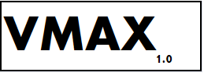

Team Member(s): D’Mita Levy, Dennis Obando, Qixiu Xin Product Owner(s): Himanshu Upadhyay
Final Presentation
Fall 2016
Virtual Machine Administration with Xen 1.0
Instructor: Masoud Sadjadi
Notes:
7 seconds.
Greet your audience, thank them for attending your presentation, introduce yourself, introduce your project, introduce your team members, and quickly indicate what each of you did in a high-level manner, and put more emphasis on your part/contribution.

Slide 2
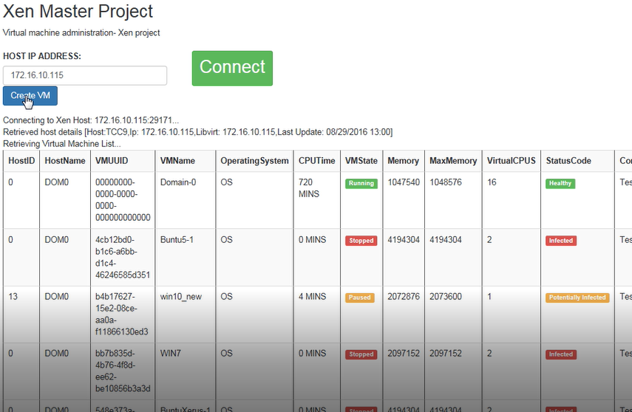
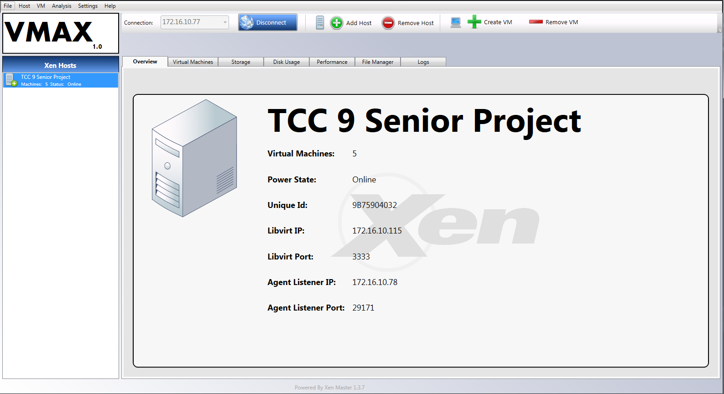
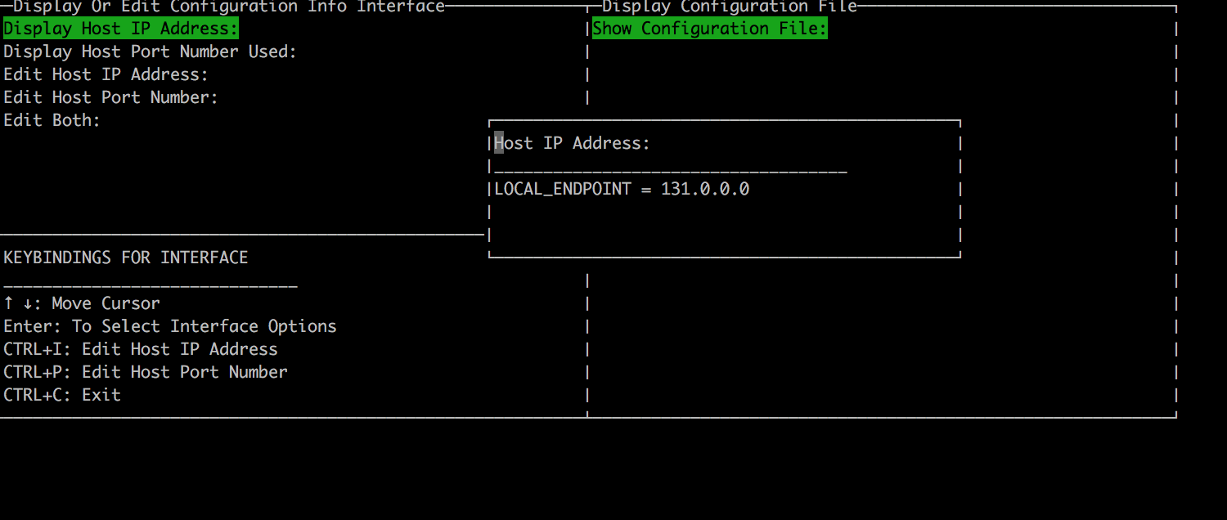
Project definition: Overview
Virtual Machine Administration with Xen (VMAX) uses the open-source Xen hypervisor management library Libvirt to provide the following solutions:
Control of the virtual machine lifecycle (start, stop, resume etc.)
Windows application client
Web based application client
Graphical hypervisor host configuration
Notes:
10 seconds.
Introduce the problem that the whole project (in all versions) tackles with GIF or screenshot.

Slide 3
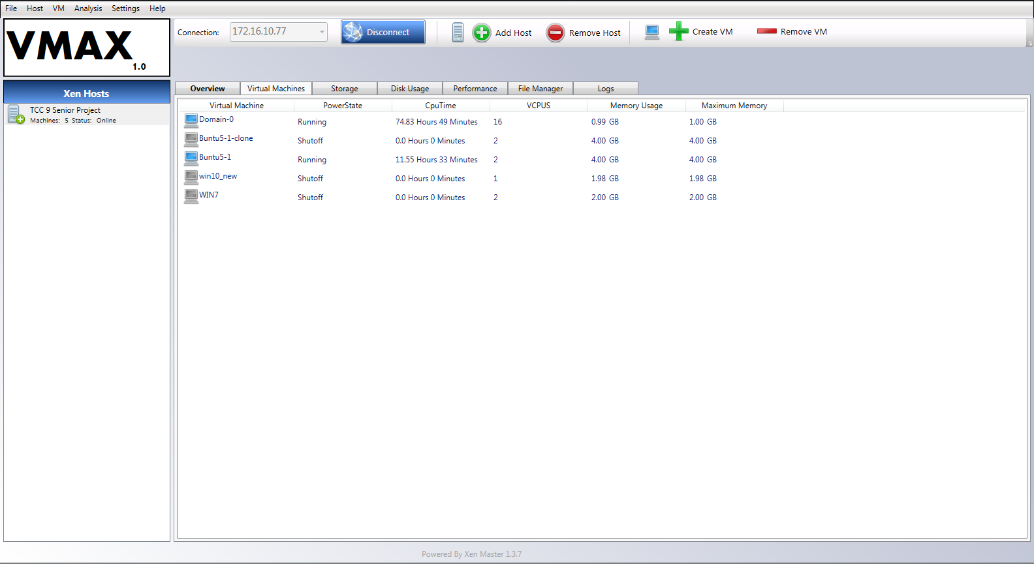
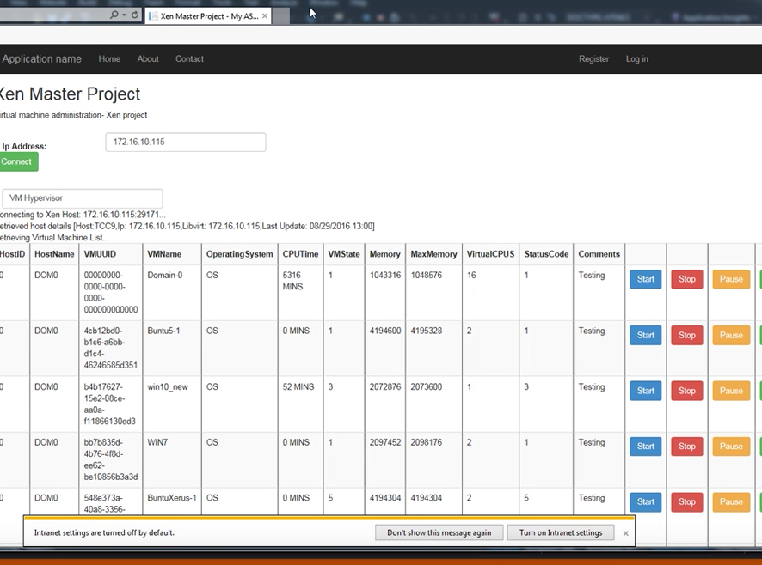
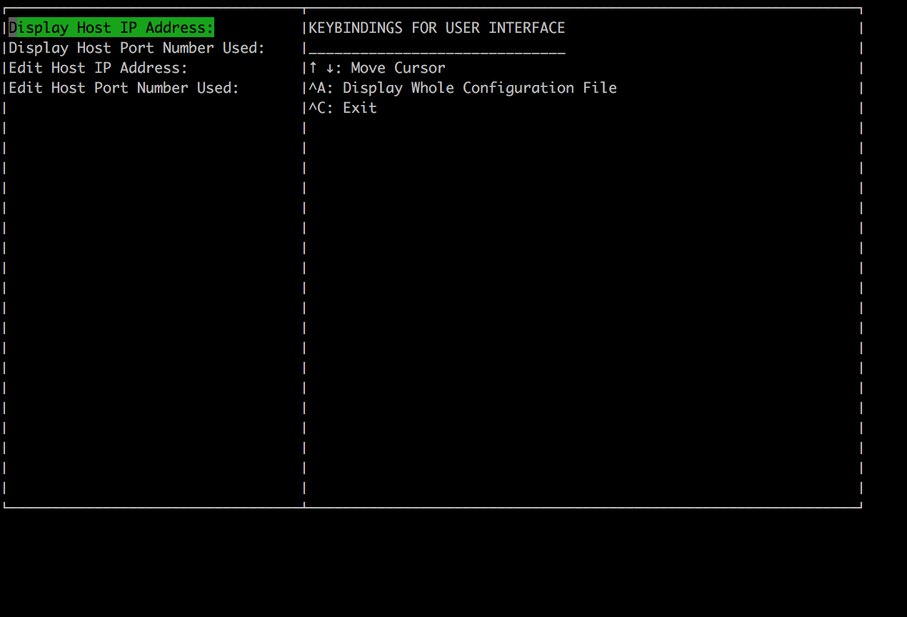
Project definition: Continued
VMAX solves the need for a cost effective, robust, Windows based Xen hypervisor management application
Windows Client
Web Client
Server Interface
Notes:
20 seconds.
Introduce the problem that the your project (in new version) tackles with GIF or screenshot.

Slide 4
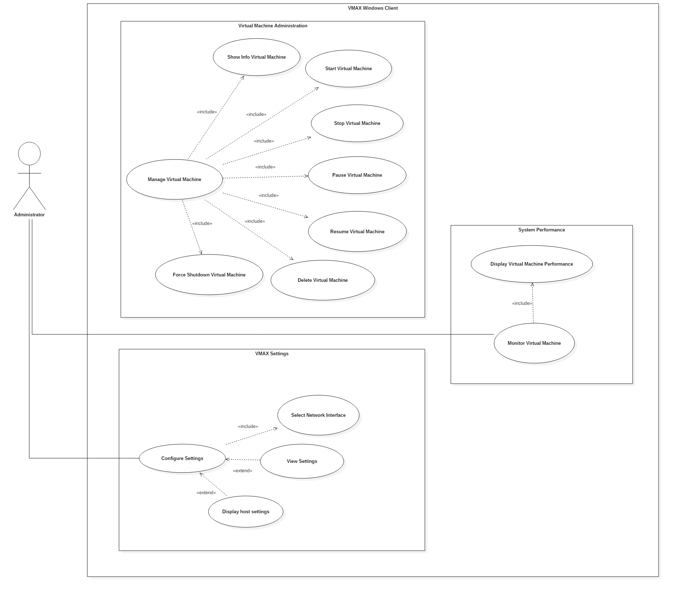
Requirements: Use Cases
Windows Client
Notes:
5 seconds
Show the Use Case Diagram for the whole project. Highlight your use cases.

Slide 6
System Design: Architecture
Client Server Architecture
Key Components
Web Client
Windows Client
Server Listener
Notes:
20 seconds
System design: Highlight the parts that you contributed to them.
1. System decomposition; identify the architecture patterns used
2. System deployment – h/w and s/w requirements

Slide 7
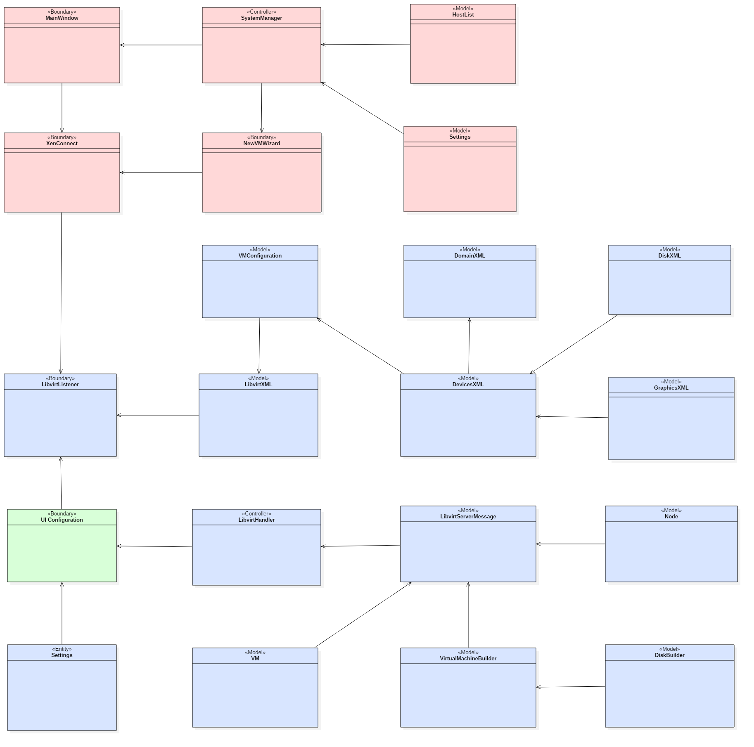
Minimal Class Diagram
Notes:
10 seconds.Minimal class diagram. Highlight the classes that you created/modified
Identify the design patterns used (one or more slides).

Slide 8
User Stories
1. User Story # 371: View File should be a separate Button/Selection
2. User Story # 420: Design the interface for multiple inputs and update
3. User Story # 232: Create A New Virtual Machine
4. User Story #143: Start A Virtual Machine
5.
6.
Notes:
5 seconds.
List the user stories that you worked on them.(put in order of importance). Stay focused on the parts that you have been working.

Slide 9
User Story #1: View File should be a separate Button/Selection
Create a separate view for selection, for the administrator to view the entire configuration file
Notes:
60 seconds
The tile of user story
The most important user story you worked on it. You have to describe this one very well and be proud of that.
Please present and show the complexity of your work, code, algorithms, and technical challenges and technologies you have used. (you could use screenshot if you want. Visual presentations are better than text presentation)
Go into the details of the most important/significant tasks using bullet lists or visual graphs or state chart diagram
Sequence Diagram for this user story is mandatory (in another separate page if required)
Demo using screenshots or GIF (in another separate page if required)

Slide 11
User Story #2: Design the interface for multiple inputs and update
Create multiple input boxes for the administrator
Submit input text in one submission to edit the host configuration settings
Notes:
20 seconds
The tile of user story
Please present and show the complexity of your work, code, algorithms, and technical challenges and technologies you have used. (you could use screenshot if you want. Visual presentations are better than text presentation) - Go into the details of the most important/significant tasks using bullet lists or visual graphs or state chart diagram - Demo using screenshots or GIF (in another separate page if required)
Sequence Diagram for this user story is optional

Slide 13
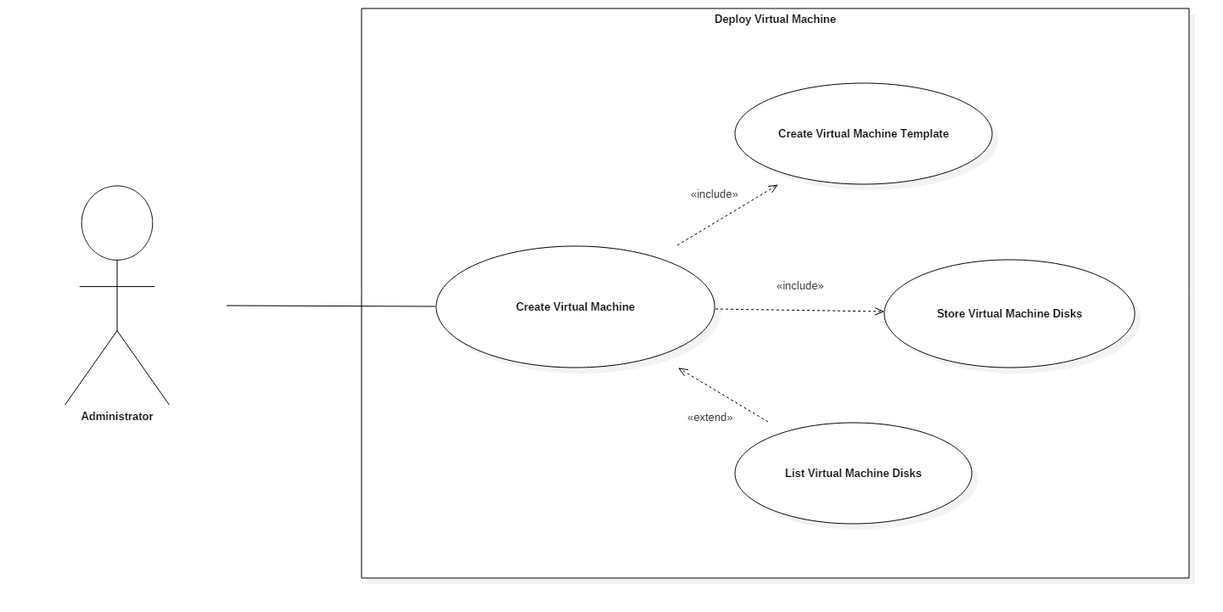
User Story #3: Create a new Virtual machine
Design an interface that will create a new virtual machine on the remote host
As an administrator I would like to be able to create a virtual machine so that others may use it
Use Case Diagram
Notes:
20 seconds
The tile of user story
Please present and show the complexity of your work, code, algorithms, and technical challenges and technologies you have used. (you could use screenshot if you want. Visual presentations are better than text presentation) - Go into the details of the most important/significant tasks using bullet lists or visual graphs or state chart diagram - Demo using screenshots or GIF (in another separate page if required)
Sequence Diagram for this user story is optional

Slide 14
User Story #3: Use Case
Use case name | Create Virtual Machine
Actors | Administrator
ID | UC_008
Preconditions | The VMAX application has populated a list of hosts and has at least one host The host has pre-loaded OS ISO images for installation
Flow of Events | The user clicks the “Create VM” button on the VMAX toolbar A “New Virtual Machine Wizard” window is opened The user selects the host machine from the “Host” drop-down The user enters the virtual machine name, memory, and cpu requirements The user selects an “Os Image” The user clicks the “Create VM” button in the Wizard A message displays the creation status of the machine The virtual machine is moved to a running state and shows up in the host list
Entry condition | The user clicks the “Create VM” button
Exit conditions | The virtual machine is created and moved to the “Running State” The virtual machine shows up in the host list
Quality Requirements | Virtual machine creation should take less than 2 minutes The machine should start in the “Running State” The user is notified of creation success and failure
Notes:
20 seconds
The tile of user story
Please present and show the complexity of your work, code, algorithms, and technical challenges and technologies you have used. (you could use screenshot if you want. Visual presentations are better than text presentation) - Go into the details of the most important/significant tasks using bullet lists or visual graphs or state chart diagram - Demo using screenshots or GIF (in another separate page if required)
Sequence Diagram for this user story is optional

Slide 15
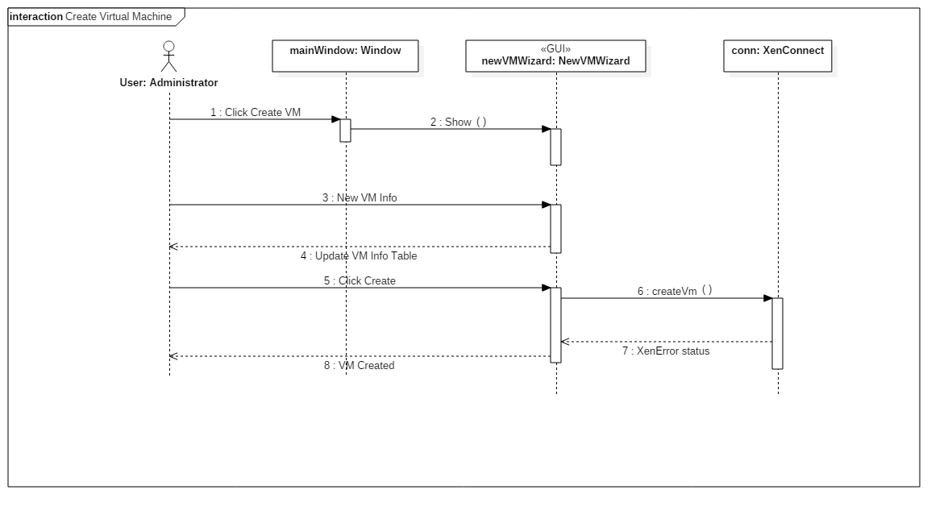
User Story #3: Sequence Diagram
Notes:
20 seconds
The tile of user story
Please present and show the complexity of your work, code, algorithms, and technical challenges and technologies you have used. (you could use screenshot if you want. Visual presentations are better than text presentation) - Go into the details of the most important/significant tasks using bullet lists or visual graphs or state chart diagram - Demo using screenshots or GIF (in another separate page if required)
Sequence Diagram for this user story is optional

Slide 16
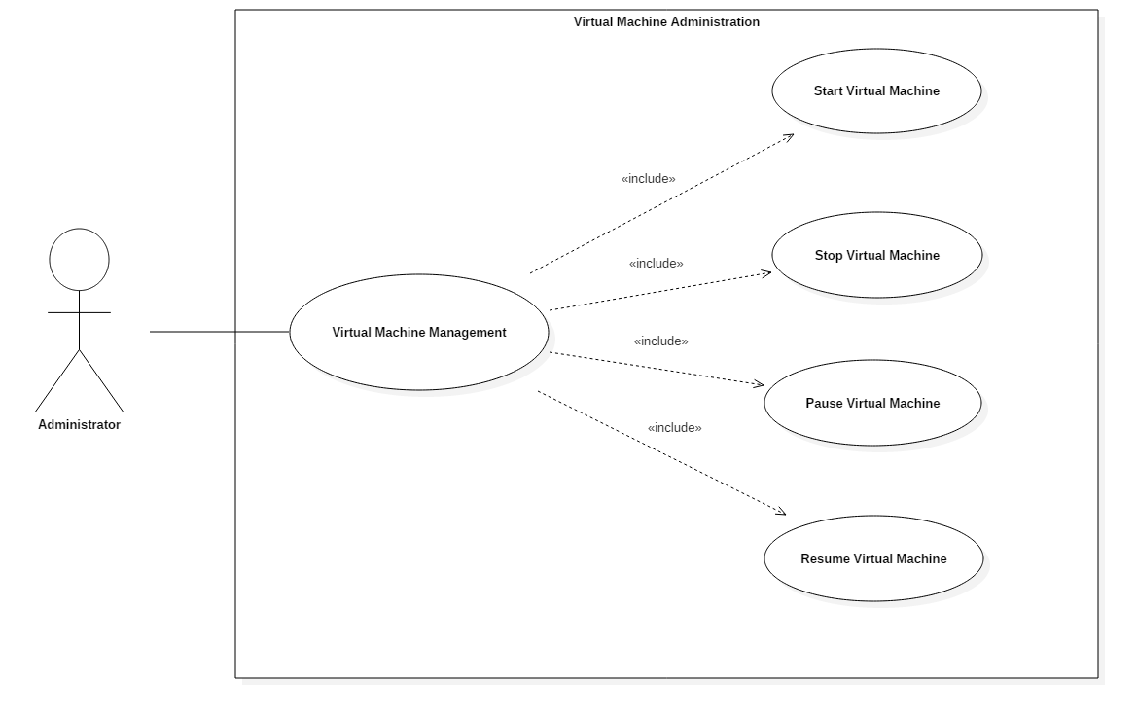
User Story #4: Start a Virtual machine
Using the XenMaster and XenConnect library, write a function that will remotely start a given virtual machine on a host
As an administrator I would like to be able to start a virtual machine so that the machine will be running and available for others to use
Use Case Diagram
Notes:
20 seconds
The tile of user story
Please present and show the complexity of your work, code, algorithms, and technical challenges and technologies you have used. (you could use screenshot if you want. Visual presentations are better than text presentation) - Go into the details of the most important/significant tasks using bullet lists or visual graphs or state chart diagram - Demo using screenshots or GIF (in another separate page if required)
Sequence Diagram for this user story is optional

Slide 17
User Story #4: Use Case
Use case name | Start Virtual Machine
Actors | Administrator
ID | UC_003
Preconditions | The VMAX application has connected to an existing host and retrieved a list of virtual machines The selected host has at least one virtual machine in the “shutdown” state
Flow of Events | The user selects a host and the host’s virtual machine list is populated The user context clicks (right-clicks) a virtual machine that is in the shutdown state A context menu is displayed next to the host The user selects the “Start” option The virtual machine is started
Entry condition | The user context clicks on a “shutdown” virtual machine and selects “Start” from the context menu
Exit conditions | The virtual machine is started
Quality Requirements | The virtual machine should start within 5-7 seconds
Notes:
20 seconds
The tile of user story
Please present and show the complexity of your work, code, algorithms, and technical challenges and technologies you have used. (you could use screenshot if you want. Visual presentations are better than text presentation) - Go into the details of the most important/significant tasks using bullet lists or visual graphs or state chart diagram - Demo using screenshots or GIF (in another separate page if required)
Sequence Diagram for this user story is optional

Slide 18
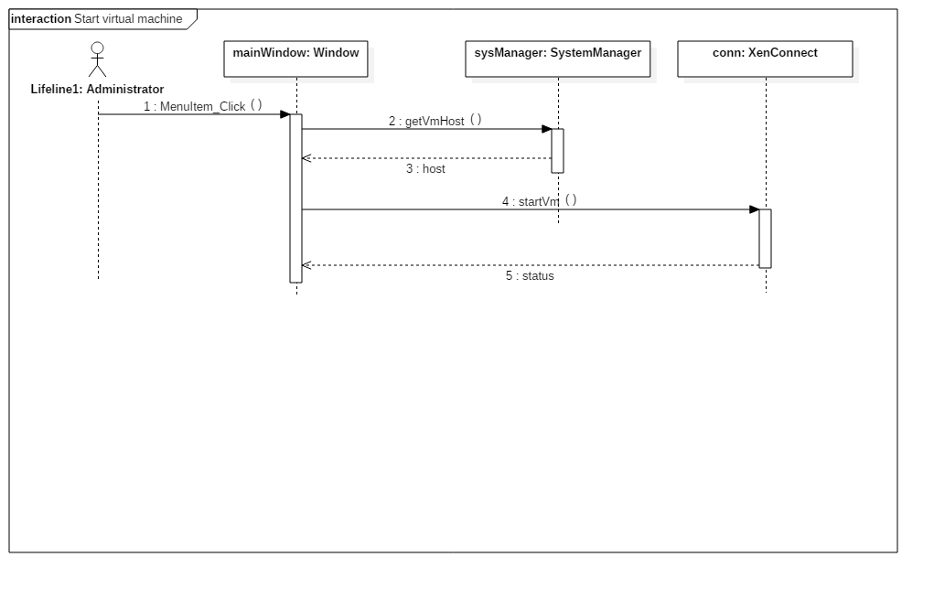
User Story #4: Sequence Diagram
Notes:
20 seconds
The tile of user story
Please present and show the complexity of your work, code, algorithms, and technical challenges and technologies you have used. (you could use screenshot if you want. Visual presentations are better than text presentation) - Go into the details of the most important/significant tasks using bullet lists or visual graphs or state chart diagram - Demo using screenshots or GIF (in another separate page if required)
Sequence Diagram for this user story is optional

Slide 19

Test Suites and Test Cases
Test ID: U-359-1
Purpose: | Test XenMaster delete virtual machine capability
Preconditions: | The virtual machine is in the shutdown state
Input: | VM UUID: (Example) “4cb12bd0-b1c6-a6bb-d1c4-46246585d351”
Expected Output: | Return object XenError Type: Success Message: The virtual machine has been deleted successfully After some time the virtual machine will be deleted and running
Integration Tests
Unit Tests
Test ID: I-186-1
Purpose: | Test the VMAX user notification logging
Preconditions: | VMAX application has started successfully There is at least one host available in the network A host is configured in the VMAX configuration/settings file
Input: | Select a host from the host list Click the “Logs” tab
Expected Output: | Logs showing the ISO disk retrieval and VHD retrieval status will be displayed: Notification ISO Retrieval Retrieved Host ISO storage List Notification VHD Retrieval Retrieved Host VHD disk list
Notes:
10 seconds
A description of verification process and Test Suites and Test Cases for one of the use cases.
1 One sunny day and one rainy day for the implemented use cases (one or more slides).
2 Automated test scripts for the implemented use cases (if any) (one or more slides).

Slide 20








Summary
Summary
contact information
Questions?
Thank You!
Notes:
10 seconds
Summarize your contribution, mention your effort for Scrum, Mingle, Github, Google Drive Documentation and minutes
Include your contact information
Ask if anyone has any questions for you.
Thank your audience

